Slide 1
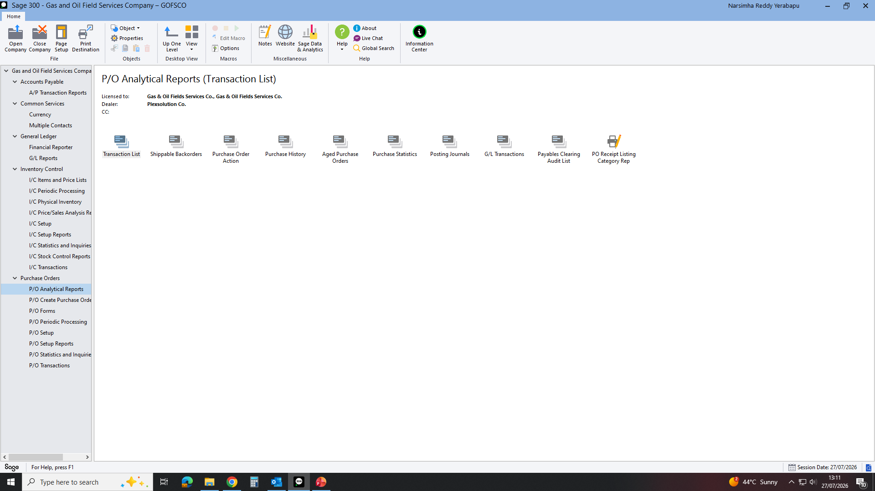
Notes:
TO GET MRV REPORT AS WE NEEDED DAY OR MONTHS NEED TO GO PURCHASE ORDERS: P/0 ANALYTICAL REPORTS THEN PO RECEIPT LISTING CATEGORY REP. THEN AS BELOW

Slide 2
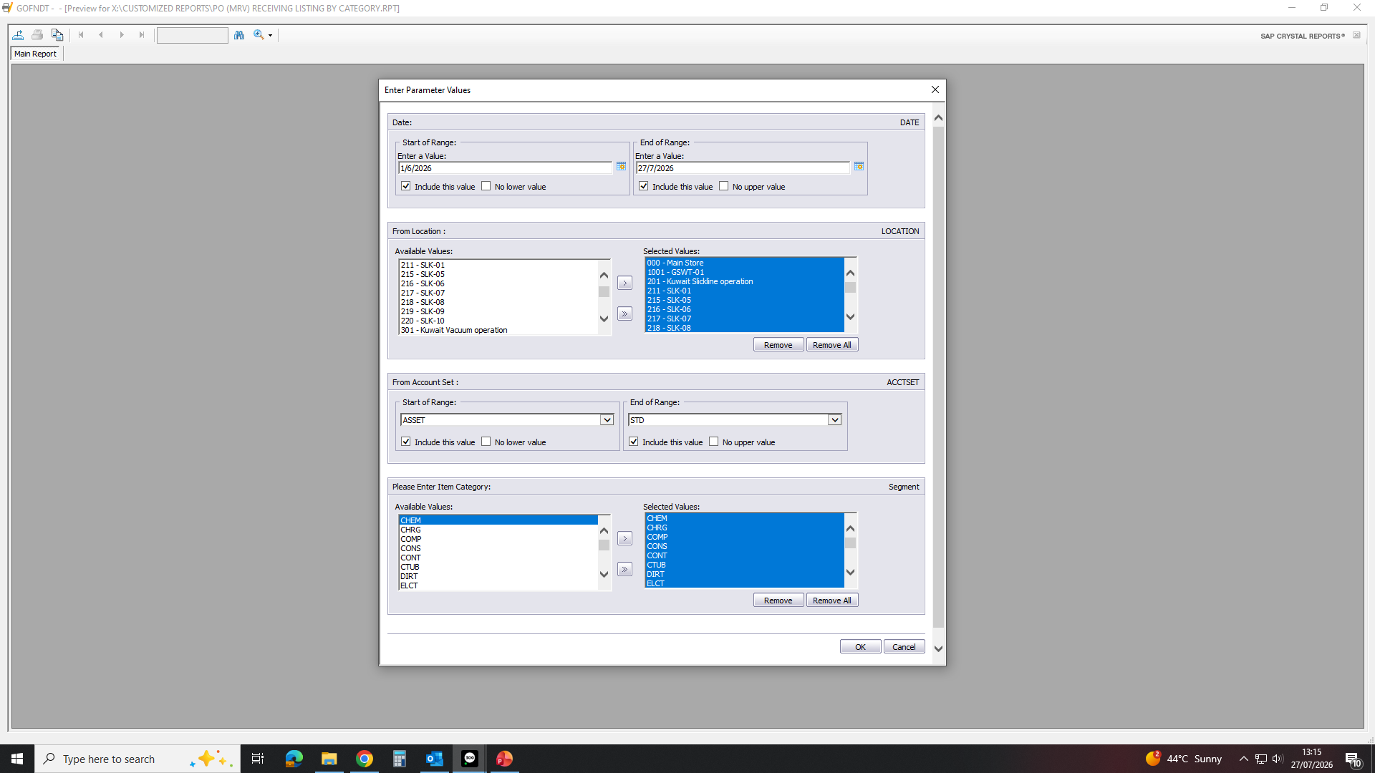
FILL AS REQUIRED DATES AND OTHER AS BELOW THEN CLICK OK WILL GET REPORT ON EXCELL SHEET AND ORGANISE AS NEEDED.

